Slide 1
Software Design and Analysis
Software Development Methodologies
Department of Software Engineering,
FAST-NUCES, CFD Campus

Slide 2
Lecture Objectives
Software Design Methodologies
Design Paradigms
Object-oriented Design Approach

Slide 3
Software Design Methodologies
In a Software development process, the Software Design Methodology (SDM) refers to:
  specific set of procedures used to create a conceptual design for fulfilling the set of requirements.
The choice of the SDM primarily depends upon several factors, namely,
  the type of the software (such as standalone or distributed and networked; Strategic or operational etc.)
  the scope of the development project (such as revamp of the existing system or new system, the number of modules involved, underlying complexity of the coding, system testing and implementation etc),
  the resources constraints (such as time, money, expertise)

Slide 4
Software Design Methodologies
Common software design approaches includes:
  Structured (Function-Oriented)
    Process functions are identified
    Process intensive tasks
    Tools use are DFD and Flow charts
Example: Inventory Management System
  Description: In an inventory management system, the Structured Approach would involve identifying and organizing the various functions or operations involved in managing inventory, such as adding new items, updating quantities, and generating reports.
  Explanation: Each function, such as adding new items to the inventory or updating existing quantities, would be treated as a separate process. The focus would be on defining clear procedures for each task and ensuring smooth interaction between different functions to manage inventory efficiently.

Slide 5
Software Design Methodologies
  Object-Oriented
Based on objects, which encapsulate data and behavior.
Uses principles like encapsulation, inheritance, and polymorphism.
Helps in creating reusable and maintainable code.
Often used with languages like Java, C++, Python.
Use Tool like
Class Diagram,
Domain model and
Sequence Diagram

Slide 6
Software Design Methodologies
  Object-Oriented
    develop an object model of a system
    To understand real-world entities and their relationship
Example: Online Shopping Platform
  Description: In an online shopping platform, the Object-Oriented Approach would involve developing an object model that represents the various entities and behaviors within the system, such as products, customers, orders, and payments.
  Explanation: Each entity, such as a product or a customer, would be represented as an object with properties (e.g., name, price) and behaviors (e.g., adding items to cart, placing orders). Relationships between entities, such as a customer making an order, would be modeled using object-oriented principles like inheritance and encapsulation.

Slide 7
Software Design Methodologies
  Data-Oriented (Data-structure-centered)
    A Data-Oriented (or Data-Structure-Centered) approach focuses primarily on organizing and processing data efficiently rather than emphasizing procedures (as in function-oriented) or objects (as in object-oriented).
    The tools used are
    ERD/Schema
    DFD
    Data Dictionary
    Graph based Models

Slide 8
Software Design Methodologies
  Data-Oriented (Data-structure-centered)
    Entities are determined for each sub-system, then entity inter-relationships are examined to develop the additional entities needed to support the relationships.
    Database and banking applications
Example: Banking System
  Description: In a banking system, the Data-Oriented Approach would focus on determining the entities (e.g., customers, accounts, transactions) and their relationships to develop an effective data structure for storing and managing banking data.
  Explanation: Entities such as customers and accounts would be identified, and their inter-relationships (e.g., a customer having multiple accounts) would be examined. Additional entities, such as transaction records, may be introduced to support these relationships. The design would prioritize efficient data storage and retrieval, ensuring the integrity and security of banking information.

Slide 9
Software Design Methodologies
Component-based
  Divide the system into components
  For large systems that can be modularized.
  Software is built using predefined, reusable components.
  Components can be independently developed and plugged into different systems.
  Promotes modularity, reusability, and efficiency.
  Tools are Component based diagram
Example: Content Management System (CMS)
Explanation: In a CMS, components such as user authentication, content creation, and content management may be implemented as separate modules or components.
These components can be reused across different sections of the CMS, providing flexibility and scalability.

Slide 10
Software Design Methodologies
Formal Methods
  Formal methods are mathematically-based techniques used for specifying, developing, and verifying software and hardware systems.
  Rely on logic, set theory, and automata theory to prove the correctness of a system rather than just testing it.
  Ensures high reliability and correctness, especially in critical systems (e.g., aerospace, banking, medical devices).
  Helps detect and eliminate design errors before implementation.
  Provides precise, unambiguous specifications.

Slide 11
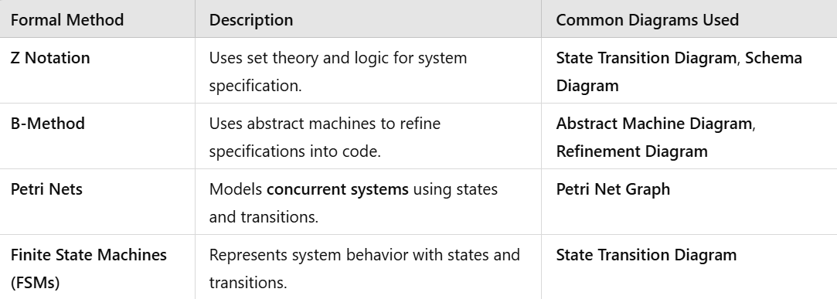
Software Design Methodologies

Slide 12
Software Design Methodologies
Formal Methods
  Requirements and programs are translated into mathematical notation
  For safety and security systems
  Expensive to implement
Key Characteristics:
Rigor: Specifications and requirements are expressed using formal mathematical languages, allowing for precise analysis and verification.
Emphasis on Safety and Security: Particularly suitable for systems where safety and security are critical, such as aerospace, medical devices, or autonomous vehicles.
Example: Air Traffic Control System
Explanation: In an air traffic control system, where safety and reliability are paramount, formal methods may be used to specify and verify the correctness of critical algorithms and protocols. Mathematical models are employed to analyze system behavior and ensure compliance with safety standards and regulations.

Slide 13
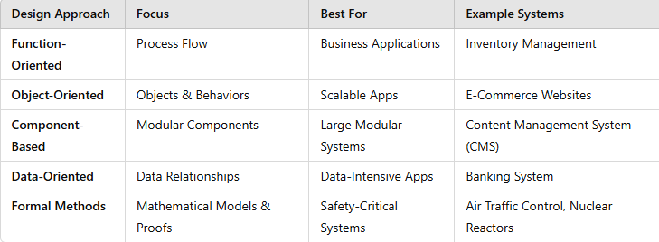

Slide 14
Software Design Paradigms
Structured Design/Function Oriented/Component Design
Object-Oriented Design

Slide 15
Software Design Paradigms - Structured
Focus on procedures and functions.
Design the system by decomposing it based on the processes and functions.
Top-down algorithmic decomposition.
This approach separates data from procedures.

Slide 16
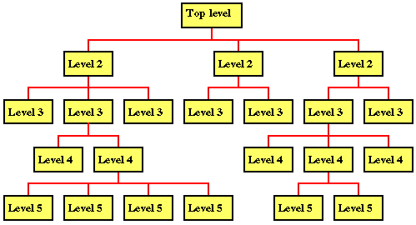
Software Design Paradigms - Structured

Slide 17
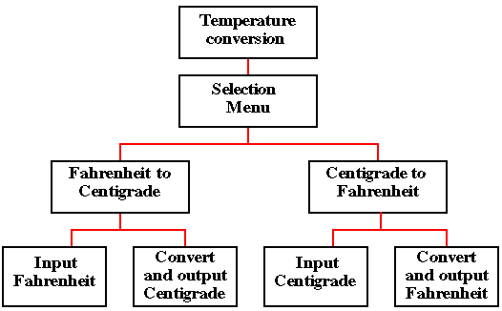
Software Design Paradigms - Structured

Slide 18
Software Design Paradigms - Structured
Drawbacks
  Interdependencies between various functions and processes.
  Cannot be reused easily, why?
  Data related to each function is not attached.

Slide 19
Software Design Paradigms – Object-Oriented Design (OOD)
Bottom-up
  Describing the software solution in terms of collaborating objects, with responsibilities.
  Encapsulate data and procedures in objects and classes.
  Refinement in classes lead to a composed larger system.
OO Design elements
  Objects,
  classes,
  encapsulation,
  States,
  inheritance,
  composition,
  polymorphism

Slide 20
Software Design Paradigms – OOD-Benefits
Enjoys all the benefits of Modular approach
Dependencies can be handled by finding the commonalities through inheritance and polymorphism.
Naturalness
  OO paradigm models the real world better because everything in real world is an object.
Reusability
  Using the existing classes or components in future design, without much effort.

Slide 21
Software Design Paradigms – OOD- Notation/Language
UML is just a standard diagramming notation.
It is just a tool, not a skill that is valuable in itself.
Knowing UML helps you communicate with others in creating software.
Determines how objects interact and what classes should perform what operations.

Slide 22
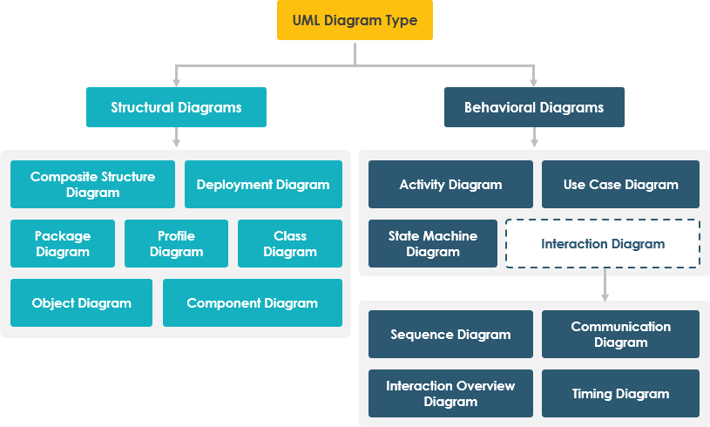
Software Design Paradigms – OOD- Notation/Language

